Slide 1

Tele Scar
TELE SCAR System Proposal
[Catch-22]
Aline Silva, up201509292
Inês Alves, up201909426
Manuela Alves, up201909430

Slide 2



Diabetic Foot Ulcers (DFUs) – Challenges and Opportunities
Challenges
Opportunities
Failure to heal DFUs is a leading cause of global amputation, disability and death among people with diabetes.
10%-20% rate of lower extermity amputation
At least 70% of such amputations are potentially preventable.
20 million people currently have an active DFU with a further 130 million either having a history of DFU or the precursor risk factor (DPN) and expected to develop a DFU in their livetime without intervention.
Diabetes care is largely dependent on patient management.
Technology can assist in effective management of DFUs and limit its devastating consequences.
Diabetic foot care costs represent the single largest category of excess medical costs associated with diabetes.
B. Najafi, Digital health for monitoring and managing hard-to-heal wounds. Elsevier Inc., 2020.
A. Cahn, A. Akirov, and I. Raz, “Digital health technology and diabetes management,” J. Diabetes, vol. 10, no. 1, pp. 10–17, 2018.
TELEMEDICINA E E-SAÚDE • TELE SCAR PLATFORM • MAY 25, 2020
A. Raghav, Z. A. Khan, R. K. Labala, J. Ahmad, S. Noor, and B. K. Mishra, “Financial burden of diabetic foot ulcers to world: a progressive topic to discuss always,” Ther. Adv. Endocrinol. Metab., vol. 9, no. 1, pp. 29–31, Jan. 2018.

Slide 3
Index
Product and Sprint Backlog
System Request
Analysis Modelling
System Requirements
Functional Modelling
Use Case Diagram
Use Case Description – High Level and Expanded
Activity Diagram
Design Modelling
Package Diagram
Interface Design Prototyping
TELEMEDICINA E E-SAÚDE • TELE SCAR PLATFORM • MAY 25, 2020

Slide 4
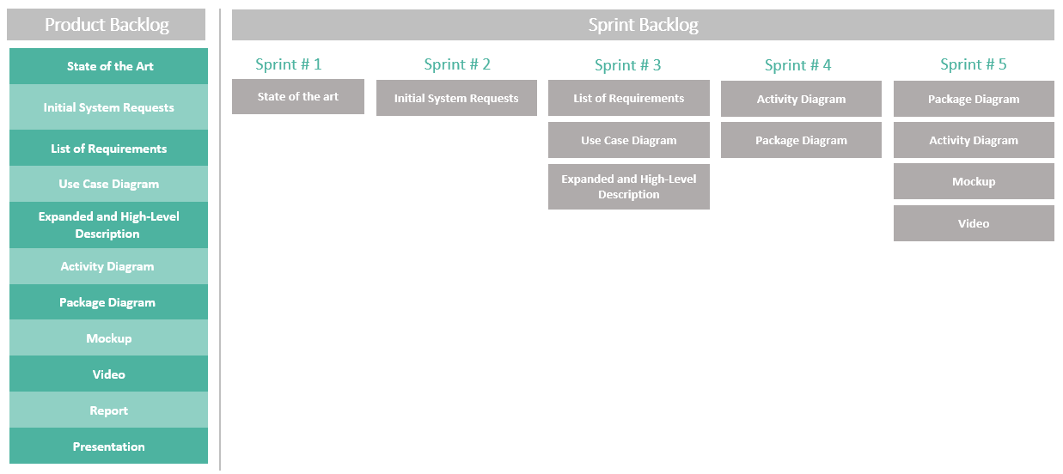

Scrum Sprint Backlog
Duration of the Sprint 1 week
TELEMEDICINA E E-SAÚDE • TELE SCAR PLATFORM • MAY 25, 2020

Slide 5
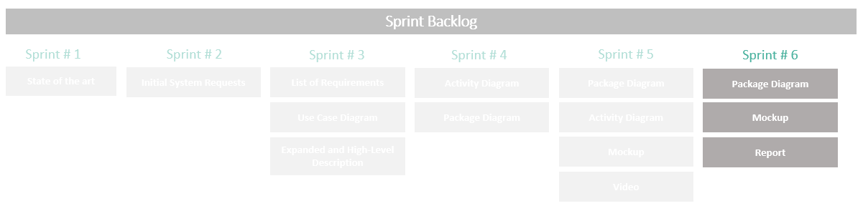
Sprint Backlog – Week 25.05.2020
TELEMEDICINA E E-SAÚDE • TELE SCAR PLATFORM • MAY 25, 2020

Slide 6
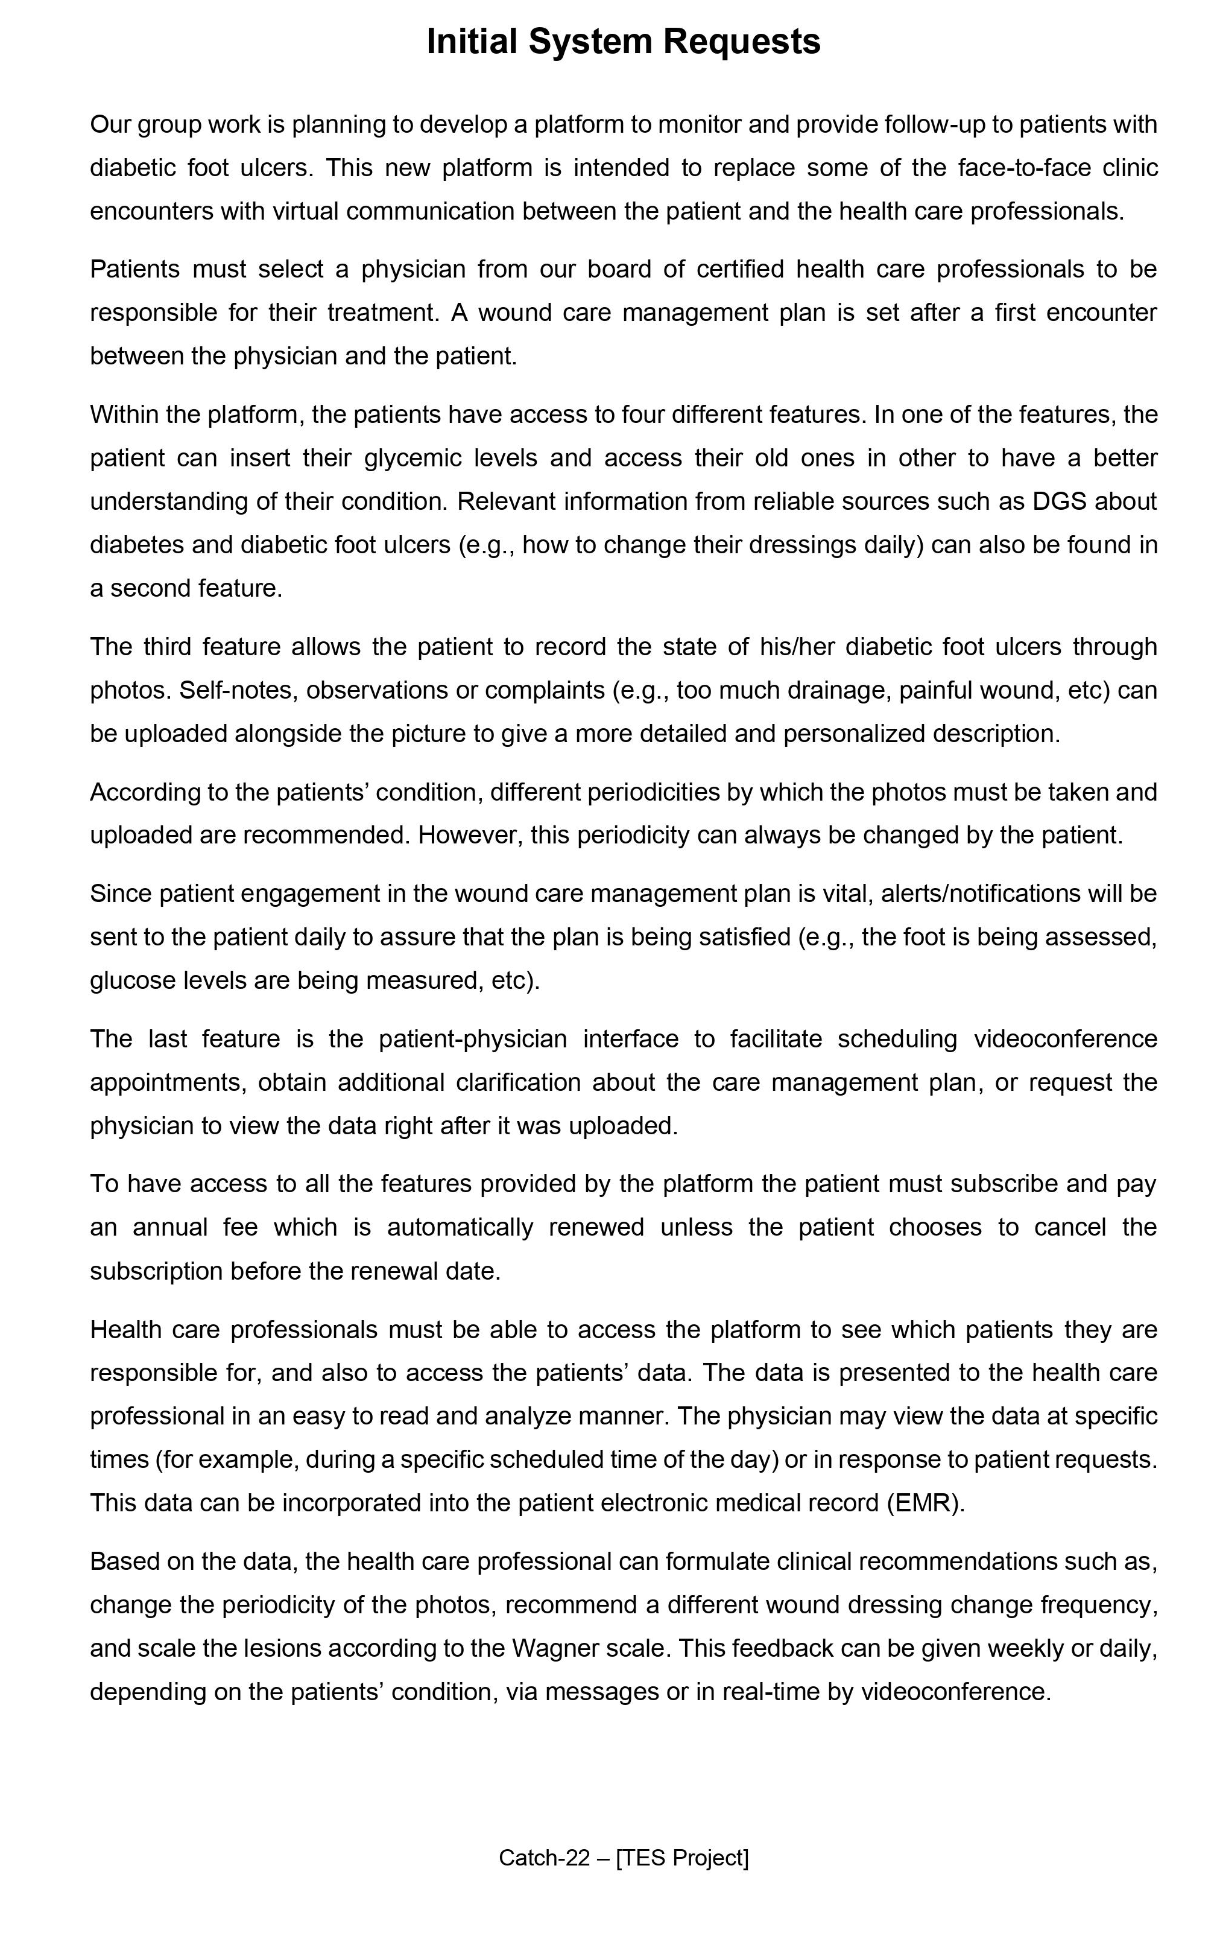

Initial System Requests Text
Platform to monitor and provide follow-up to patients with DFUs.
Provides a new way for health care professionals to partner with and interact with their patients.
Intended to replace some of the face-to-face clinic encounters with virtual communication.
Communication with medical personnel (videoconference and text);
Photographic follow-up;
Personalized and easy-to-understand management guidelines;
Assist in engaging patients to manage their DFUs;
TELEMEDICINA E E-SAÚDE • TELE SCAR PLATFORM • MAY 25, 2020
6

Slide 7
Index
System Request
Workplan
Analysis Modelling
System Requirements
Functional Modelling
Use Case Diagram
Use Case Description – High Level and Expanded
Activity Diagram
Design Modelling
Package Diagram
Interface Design Prototyping
TELEMEDICINA E E-SAÚDE • TELE SCAR PLATFORM • MAY 25, 2020
7

Slide 8
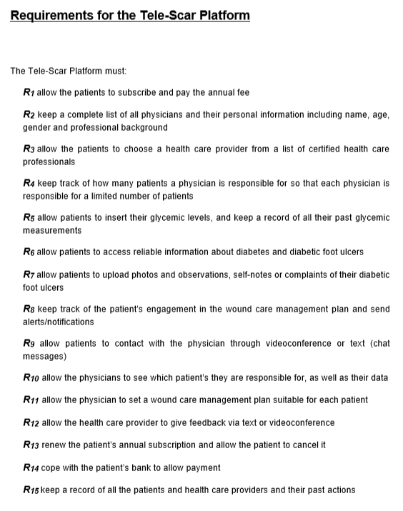

System Requirements
Non-Functional
Functional
The system will operate on any web browser including mobile
The system must be available 24 hours daily (365 days per year)
Final list containing 15 Functional Requirements
Access to patient medical information is limited to medical staff only
TELEMEDICINA E E-SAÚDE • TELE SCAR PLATFORM • MAY 25, 2020

Slide 9
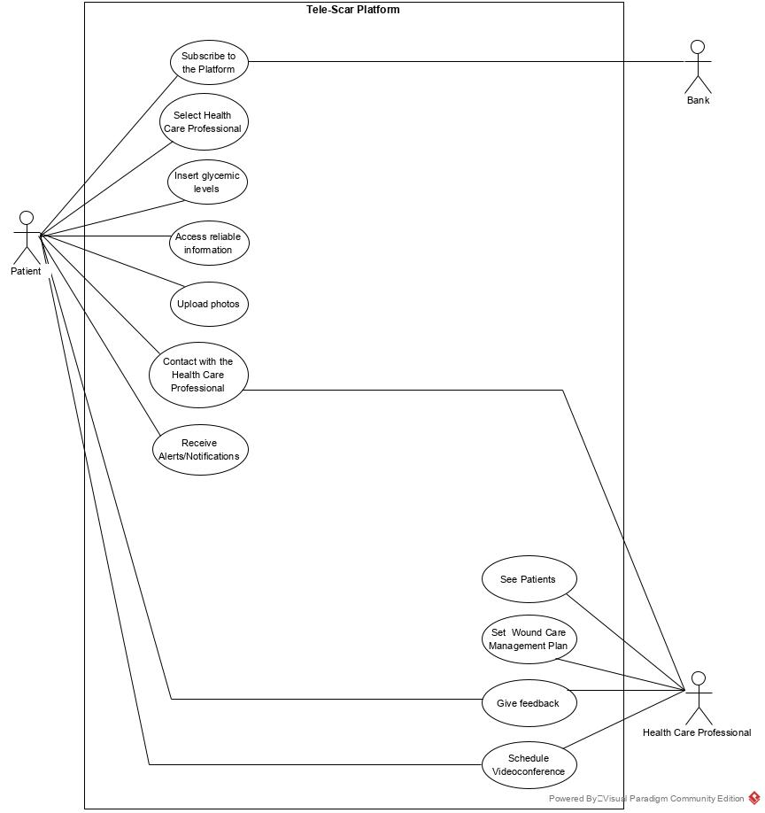
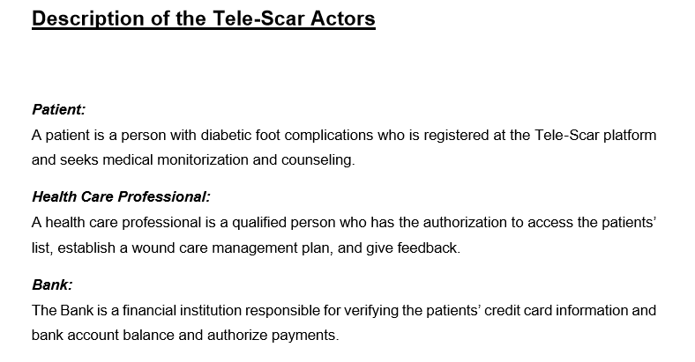
Functional Modeling - Use Case Diagram
TELE SCAR ACTORS - DESCRIPTION
TELEMEDICINA E E-SAÚDE • TELE SCAR PLATFORM • MAY 25, 2020
9

Slide 10
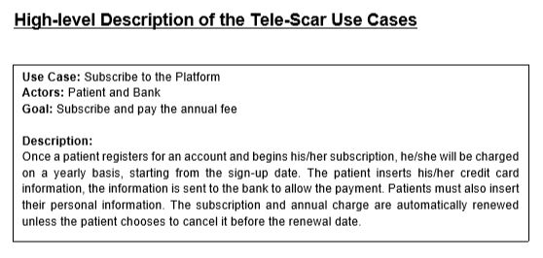
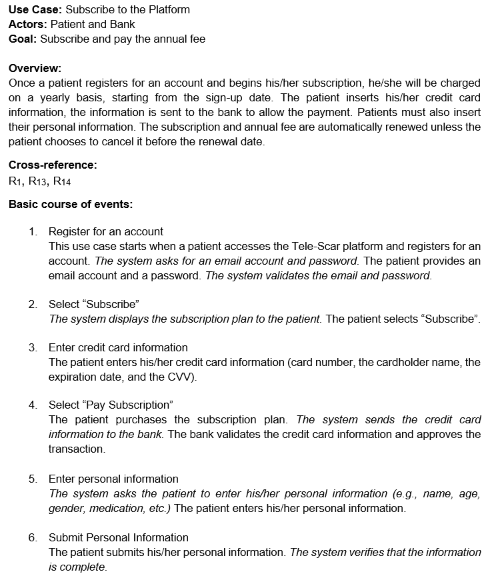
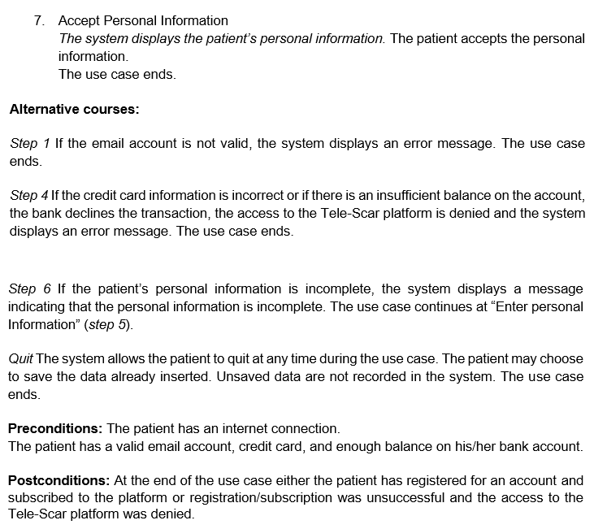
Functional Modeling - Use Case Description
Example : Subscribe to the Platform Use Case
HIGH LEVEL DESCRIPTION
EXPANDED DESCRIPTION
1
Description
Basic path
Alternative path
Pre-condition
Post-condition
2
3
4
5
TELEMEDICINA E E-SAÚDE • TELE SCAR PLATFORM • MAY 25, 2020

Slide 11
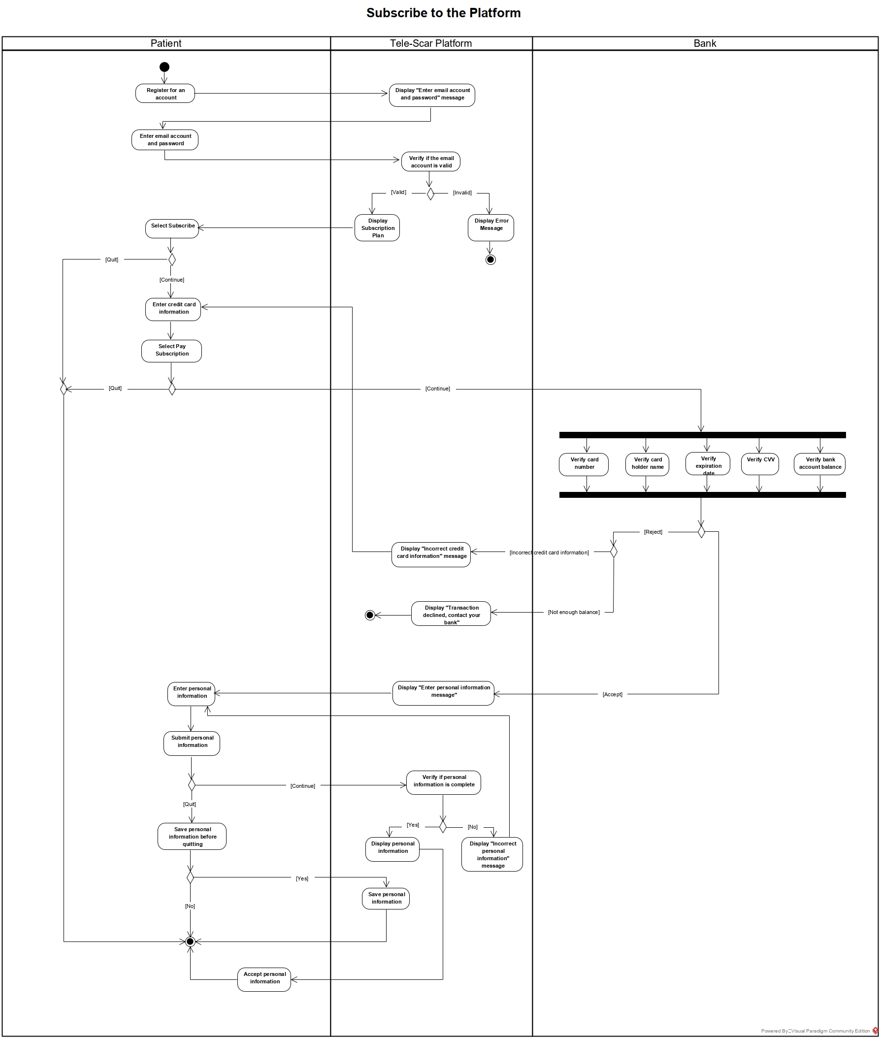
Functional Modeling - Activity Diagram
Not all of the Use Cases were modelled in Activity Diagrams, only those who had more than 3 Alternative Courses of Events
Contact with the Health Care Professional Use Case
Select Health Care Professional Use Case
Schedule Videoconference Use Case
Insert Glycemic Levels Use Case
Upload Photos Use Case
Example : Subscribe to the Platform Use Case
TELEMEDICINA E E-SAÚDE • TELE SCAR PLATFORM • MAY 25, 2020

Slide 12
Index
System Request
Workplan
Analysis Modelling
System Requirements
Functional Modelling
Use Case Diagram
Use Case Description – High Level and Expanded
Activity Diagram
Design Modelling
Package Diagram
Interface Design Prototyping
TELEMEDICINA E E-SAÚDE • TELE SCAR PLATFORM • MAY 25, 2020

Slide 13
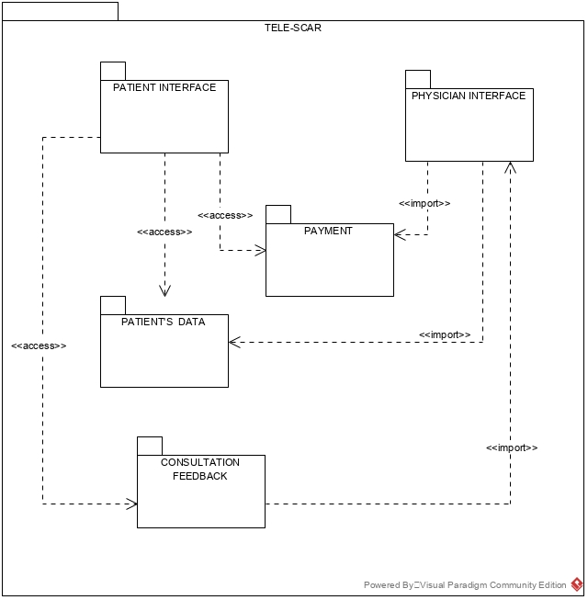
Design Modeling – Package Diagram
TELEMEDICINA E E-SAÚDE • TELE SCAR PLATFORM • MAY 25, 2020

Slide 14


Slide 15
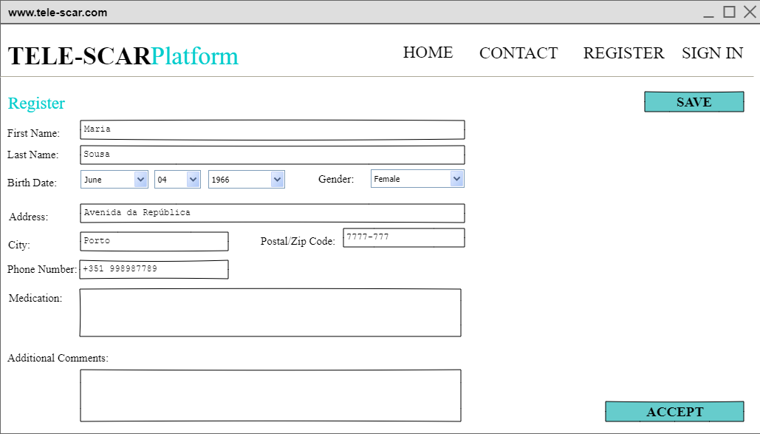
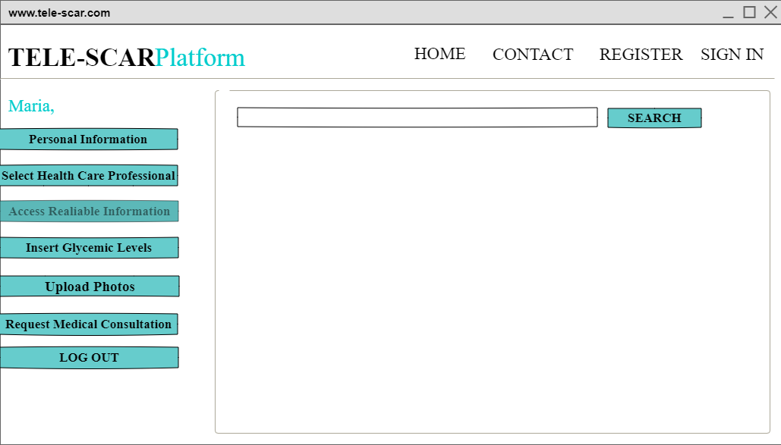
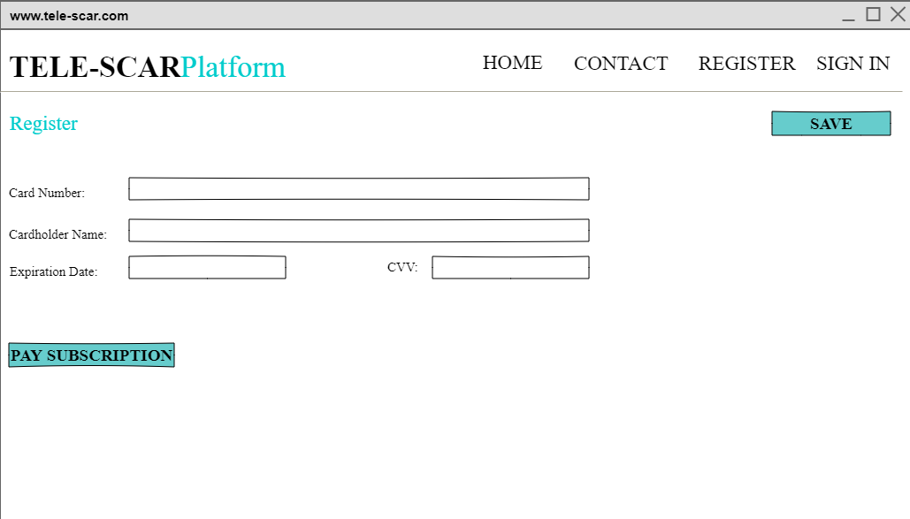
Design Modeling – User Interface Prototypes
file:///C:/Users/ifta9/Desktop/projeto/teste/index.html
TELEMEDICINA E E-SAÚDE • TELE SCAR PLATFORM • MAY 25, 2020

