Slide 1
TELE-SCAR Platform
TELEMEDICINE AND E-HEALTH
Catch 22
Aline dos Santos Silva
Inês Filipa Tavares Alves
Maria Manuela Tavares Alves

Slide 2
Watch Vídeo

Slide 3
SPRINT Plan
Sprint meeting 1
& test
Sprint meeting 2
& test
Sprint meeting 3
& test
Sprint meeting 4
& test
Sprint meeting 5
& test
Delivey
Conception Clarification
Specification
State of the art
Initial System Requirements
Step-by- Step: Outlines
Expanded Description – Use case
Activity Diagram/ Package Diagram
Deployment of content
Week 1
Week 2
Week 3
Week 4
Week 5
Week 6
April - May /2020

Slide 4
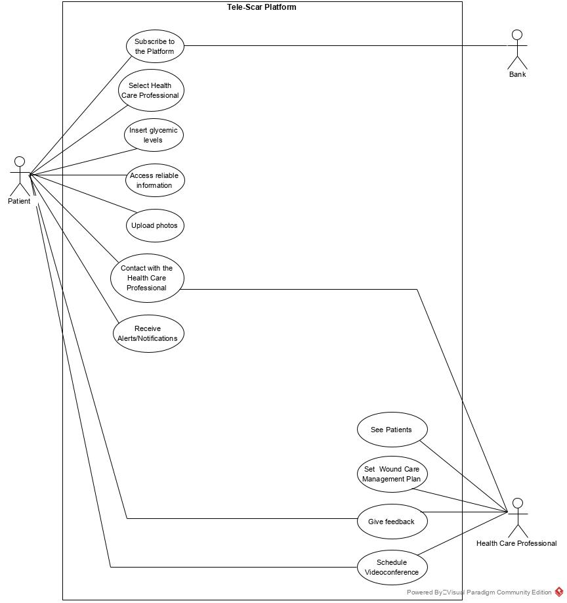
Use case

Slide 5
Mockup

